Slide 1


Slide 2
Grade 1: NEEDS and WANTS
Introduce yourselves. Include your grade and a little bit about you. Explain that you are taking a class on Financial Literacy and in it you learn ways to be a better consumer/shopper and a lot of lessons about becoming an adult. Because you are almost out of high school, it’s very important to learn life lessons.
Tell the classes that today we are going to share a lesson on NEEDS and WANTS. This is also a very good life lesson. Tell them it will begin with a story

Slide 3
Today’s Vocabulary:
Needs
Wants
Choices
Resources (Money)

Slide 4
Your Presenters:
Add a slide for each of the presenters

Slide 5
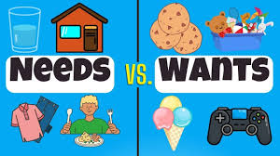
Needs
What are some examples?
Wants
What are some examples?

Slide 6
Have you ever gone grocery shopping with someone? What kinds of things do they sell in a grocery store that you like?
Today we’re going to be talking about the things we want, and how we can’t always get everything we want. We will be watching a story of a family that takes a trip to the grocery store. It’s called Something Good, by Robert Munsch. The pictures in the story were made by Michael Martchenko. This book is especially fun because Mr. Munsch writes about his own family, and Mr. Martchenko’s drawings look just like them!
The little girl in this story, Tyya (pronounced tie-ya), is unhappy because her dad never buys anything “good” at the grocery store. Let’s see what happens.

Slide 7

Something Good by Robert Munsch

Slide 8
Let’s talk about the story!
Tyya said that sometimes her dad doesn’t buy “good” food. What kind of things did her dad buy?
What did Tyya consider “good” food?
What was funny about the foods Tyya tried to get her father to buy?
What did her dad call the food she picked out?
Why do you think some of the people thought Tyya was a doll?
How much did the lady who worked at the store decide to sell Tyya for?
Why do you think Tyya’s dad paid $29.95 to buy Tyya?

Slide 9
Lets go over today’s lesson:
Even though people have wants, they can’t have everything. There are lots of reasons why we can’t have everything we want, but today we’re going to talk about one reason: resources. A resource is something that helps you get the things you want. the best example of a resource is MONEY
The problem with resources is that we don’t always have enough resources or money to get everything we want.
There is an end to the amount of money people have. Because money has a limit, we call it a limited resource.
Do you think Tyya’s father had enough money to buy all the ice cream and chocolate bars AND all the other groceries his family needed?

Slide 10
Choices
Making a choice means to decide just what you will use your resources on. Spend your resources on the things you need first, and if there is any left over, then get some of the things you want. Tyya’s father was doing that in the story: he was choosing the groceries that his family needed. Remember what he called the ice cream and chocolate bars?
He decided his family didn’t need sugary junk, so he wouldn’t spend his money on those things.
Why did he spend his money buying Tyya?

Slide 11
Resources
Why can’t we have everything?
Resources are limited!!
Not enough money
Not enough hours to work
A limited number of products

Slide 12
So we can say that Tyya and her family had wants—meaning if they could, they would have bought hundreds and hundreds of things in the store. But they also had limited resources—meaning there wasn’t enough money to buy all the things they wanted. Tyya’s father had to think about his limited resources. Then he had to think about what his family needed. Do you think his family needed 100 boxes of ice cream and 300 chocolate bars?
Do you think they needed bread, eggs, milk, cheese, and spinach?
When you don’t have enough resources to get everything you want, you sometimes have to make a choice.

Slide 13
Now lets play a little game about “Needs and Wants”
Let’s look at some items and you can help decide if they are needs or wants

Slide 14


Needs or Wants Game
Is this a need or want?
Is this a need or want?

Slide 15

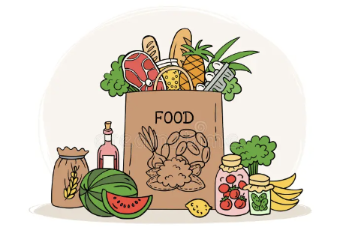
Needs or Wants Game
Is this a need or want?
Is this a need or want?

Slide 16


Needs or Wants Game
Is this a need or want?
Is this a need or want?

Slide 17
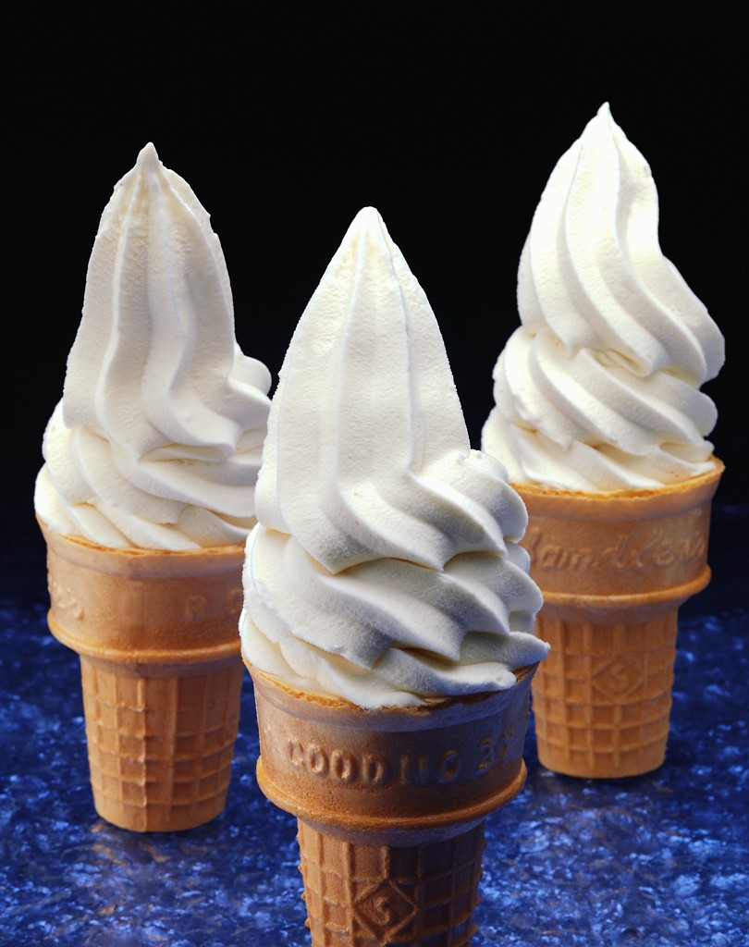
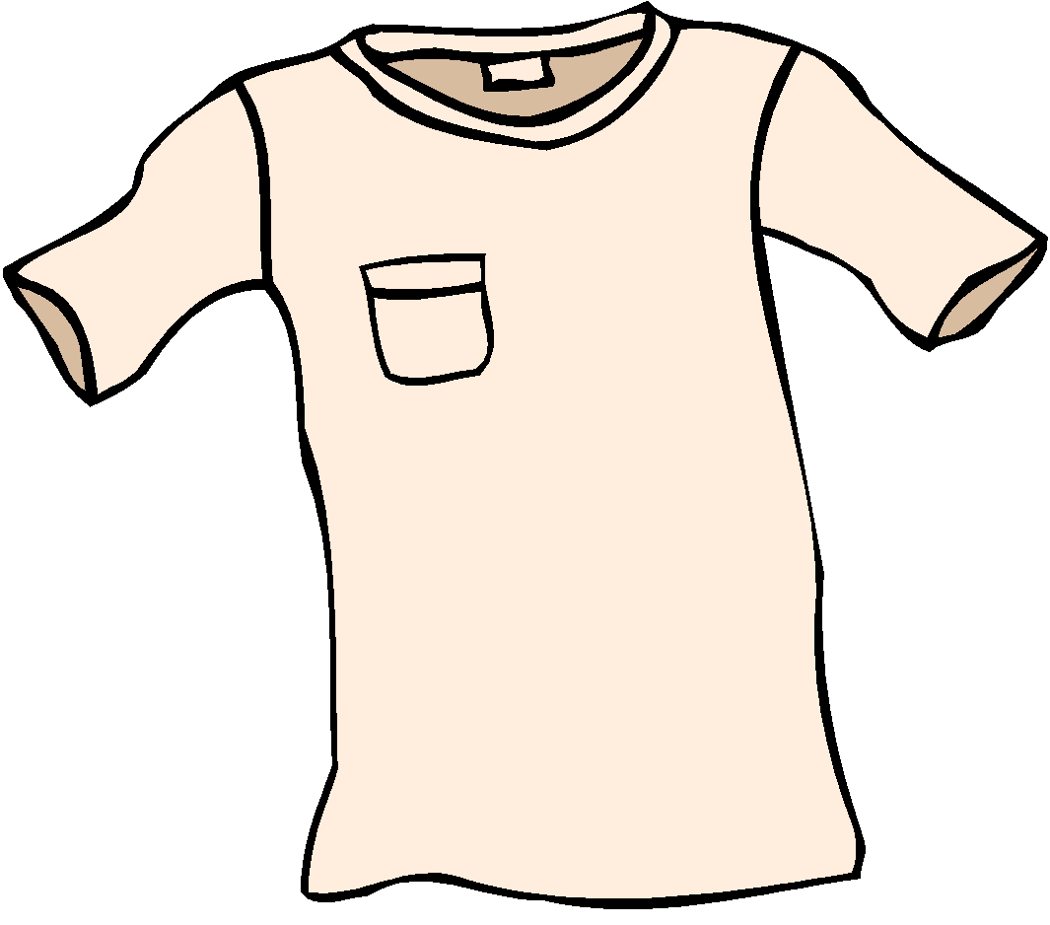
Needs or Wants Game
Is this a need or want?
Is this a need or want?

Slide 18


Needs or Wants Game
Is this a need or want?
Is this a need or want?

Slide 19
THANK YOU!!!
Thank you so much for being great students and letting us share this lesson on needs and wants with you.
We hope you will remember what we talked about the next time you want your parents to buy you that little something extra.
Just remember, your parents have to take care of the NEEDS of your family before they can spend the extra on the WANTS that you would like.

Slide 20


